Slide 1
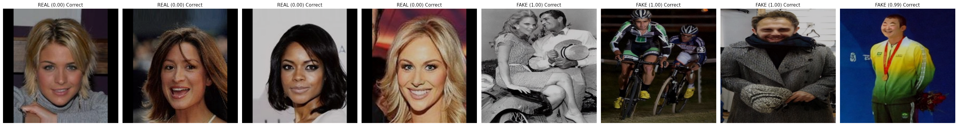
UnFooled: Attack‑Aware Deepfake & Image Forensics
Noor Fatima, Muzammil Behzad — KFUPM

Slide 2
Agenda
Motivation & Problem
Research paradigm
Method (architecture + training/testing)
Datasets & protocol
Metrics
Results
Contributions, limitations, future work

Slide 3
Motivation: Why this matters
Deepfakes impact journalism, governance, legal workflows.
Detectors degrade after routine platform handling (recompress/resize) & counter‑forensics.
Beyond a label, analysts need where the evidence is.
Goal: Detection must deliver decisions that remain stable under routine degradations—recompression, resizing, relighting—and under intentional counter-forensics.
Detection remains a moving target because the artifacts exploited by algorithms are not fixed properties of media; they mutate once adversaries understand what a detector attends to.

Slide 4
Problem Statement & Threat Model
Task: (a) Real vs Fake; (b) Weak localization (heatmap) after attacker edits.
Attacks: jpeg (realign + recompress), warp (subpixel resampling), regrain (denoise then add synthetic grain), seam (boundary smoothing), gamma (mild tone mapping), and transcode (social-app–style re-encoding).
Constraint: Edits keep content plausible; aim to suppress/spoof forensics.
The central problem is to detect manipulated media and indicate manipulated regions in the presence of chosen adversarially visually subtle edits that preserve narrative content.
while suppressing or spoofing forensic evidence

Slide 5
Research Questions (RQs) & Goals (RGs)
RQ1: Which counter‑forensics hurt most?
RQ2: Do attack‑aware training + Test-Time Augmentation improve worst‑case robustness & calibration?
RQ3: Does fusing content + residuals help when one cue is weakened?

Slide 6
Research Paradigm
Paradigm: Design & construction of a two‑stream detector + experimental evaluation under realistic stress.
Formalization: Losses/objective for robustness & weak localization.
A deployment-oriented detector that is robust under realistic counter-forensics, calibrated for decision-making, and able to surface spatial evidence with weak supervision.

Slide 7
Related Work
Datasets/protocols: FaceForensics++, DFDC (compression‑aware).
Detectors: semantic (Xception), boundary (Face X‑ray), frequency (F3‑Net), generic localizers (ManTra‑Net).
Defenses: randomized input transforms; counter‑forensics increasingly practical.
These advances don’t consistently report worst‑case robustness, calibration, or provide weakly‑supervised evidence maps.

Slide 8
Challenges in Current Techniques
Train–deploy mismatch: Real media is re-encoded, filtered, or lightly edited; models trained on pristine data overfit and break under these benign shifts.
Feature bias: Content-focused methods miss subtle manipulation traces; artifact-focused ones are brittle to simple denoise/regrain steps.
Blunt augmentations: Heavy, generic augments can erase the very forensic signals detectors need.
Optimistic evaluation: Many results come from clean test sets or metrics that ignore worst-case counter-forensics.
Weak labels vs hard metrics: Precise tamper masks are rare; judging with strict IoU on coarse face regions is ill-posed and inconsistent.

Slide 9
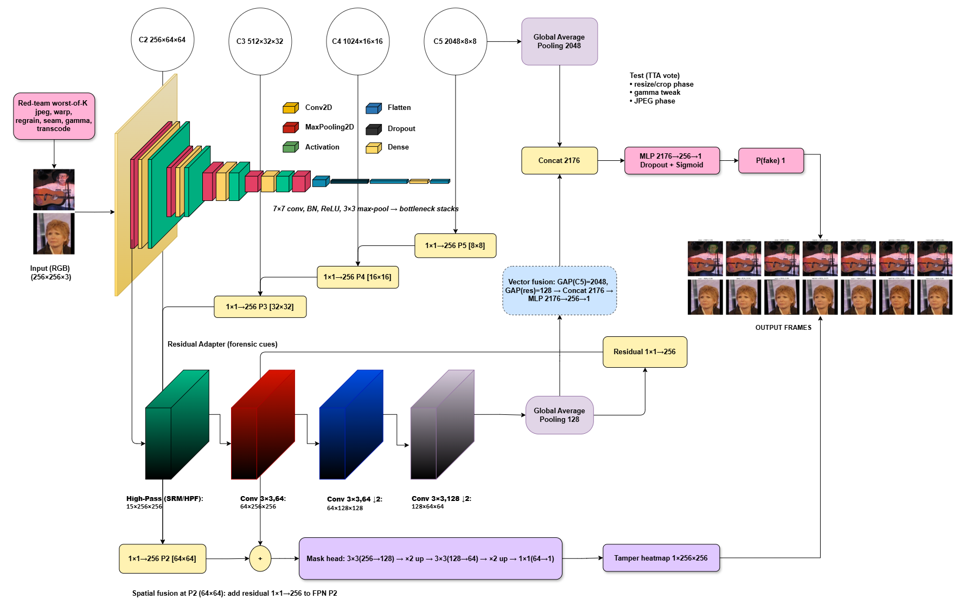
System Architecture

Slide 10
Method Overview
UnFooled is a two-stream, attack-aware detector.
The Content Stream extracts semantic/content features with a collapsed ResNet-50 and makes the real/fake decision.
The Residual stream extracts forensic residual cues (high-frequency traces). Forensic branch fed by SRM/HPF (high-pass/Spatial Rich Model filters) + a small CNN to emphasize noise/edge artifacts rather than content.
Injects them into a light FPN (Feature Pyramid Network) style mask head to produce a tamper heatmap.
Training uses worst-of-K red-team attacks; testing uses randomized TTA (resize‑phase, gamma, JPEG phase) with voting.

Slide 11
Method
Input → Red-team (train): For each image, apply the hardest of jpeg/ warp/ regrain/ seam/ gamma/ transcode (worst-of-K).
Two streams: Content (ResNet-50): C5 → GAP 2048 → concat; contributes semantics for the decision. Residual (SRM/HPF + small CNN): 128×64×64 → GAP 128 (for decision) and 1×1→256 P2 (for mask).
Fusion & head: Concat 2176 (=2048+128) → MLP(256) → P(fake).
FPN mask head: P5→P2 top-down; residual injected at P2; 3×3 + upsampling → 1×256×256 tamper heatmap.
Test-time (TTA): small resize-phase, gamma, JPEG phase jitters; logit-mean for class prob, max/mean for heatmap.

Slide 12
Method cont.
Classification: BCEWithLogits (on the image-level fake/real logit).
Mask head: weighted BCE + soft Dice (class imbalance tamper heatmap).
Regularizers on mask: edge agreement, size, cross‑view consistency.
classification + (attacked-view mask) + (clean-view mask) + regularizers.
Worst-of-K aligns training with the evaluation

Slide 13
Datasets & Preprocessing
DeepFakeFace (no new forgeries synthesized), CelebA (for real).
Surveillance‑style split: low light + heavy compression.
Weak priors from InsightFace boxes softened with Gaussian; recomputed per attacked image.
Ethics: We intentionally avoid generating new fakes; all stresses applied to existing data with fixed parameter ranges.

Slide 14
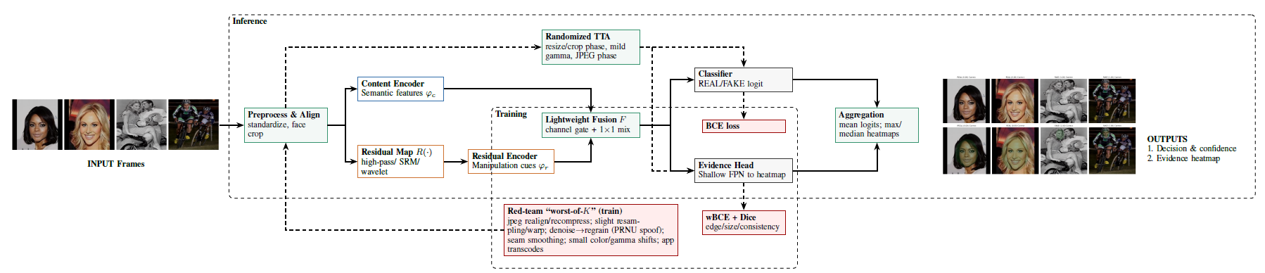
Implementation & Inference
PyTorch, mixed precision, fixed seeds; 2 epochs fine‑tune; batch=32; AdamW 1e‑4.
Mask head native 256²; upsampled to input size for loss & overlays.
Inference: N=3 TTA jitters; logit average; heatmap max‑pool.

Slide 15
Evaluation Protocol & Metrics
Threshold-free: AUC — Area Under the (ROC) Curve: ranking quality over all thresholds. AP — Average Precision (area under the precision–recall curve).
ACC(τ) — Accuracy at threshold τ (fraction correct after choosing a single decision threshold).
ECE — Expected Calibration Error (average gap between predicted confidence and actual accuracy).
Brier — Brier Score (mean squared error of predicted probabilities vs. labels).
NLL — Negative Log-Likelihood (cross-entropy of predicted probabilities).
AURC — Area Under the Risk–Coverage curve (overall error when allow abstention as coverage decreases).

Slide 16
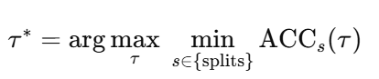
Evaluation Protocol & Metrics
Why a single global τ*
τ* is the single global decision threshold picked on the validation set to work for all conditions (clean + every attack).
Chosen on validation to maximize worst-case accuracy.
Avoids per-attack tuning.

Slide 17
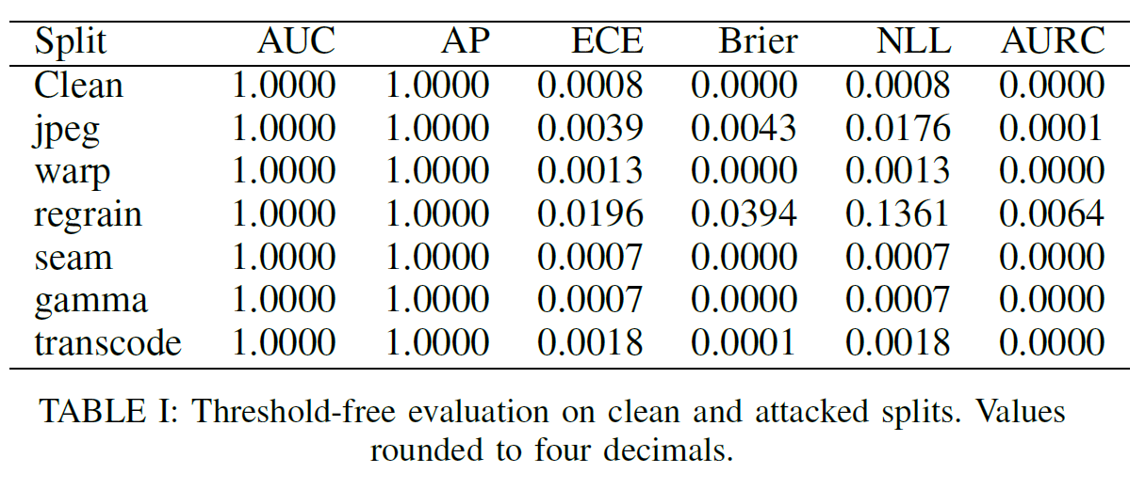
Results
AUC = 1.00, AP = 1.00 on clean & all attacks.
ECE low overall; regrain is the hardest stressor (largest calibration shift).
AURC near zero (low abstention risk).

Slide 18
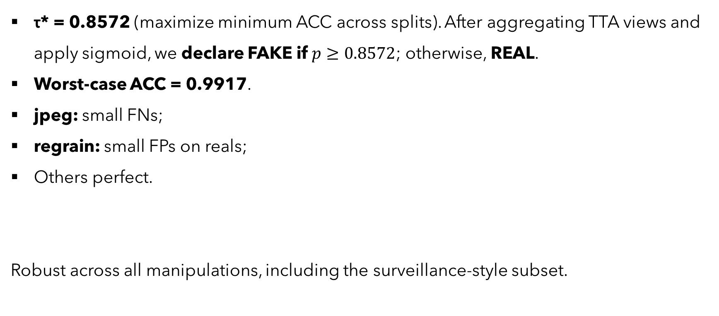
Results: Operating Point & τ*
τ* = 0.8572 (maximize minimum ACC across splits). After aggregating TTA views and apply sigmoid, we declare FAKE if $p≥0.8572$; otherwise, REAL.
Worst‑case ACC = 0.9917.
jpeg: small FNs;
regrain: small FPs on reals;
Others perfect.
Robust across all manipulations, including the surveillance‑style subset.

Slide 19
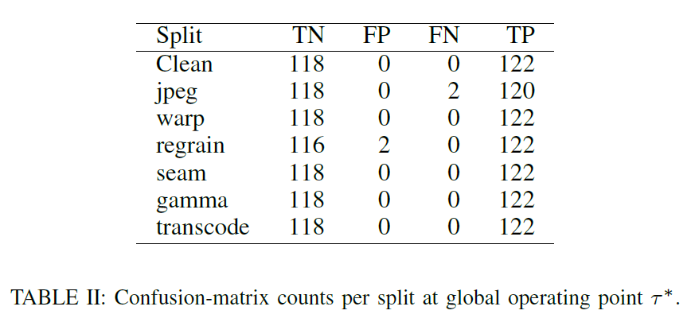

Slide 20
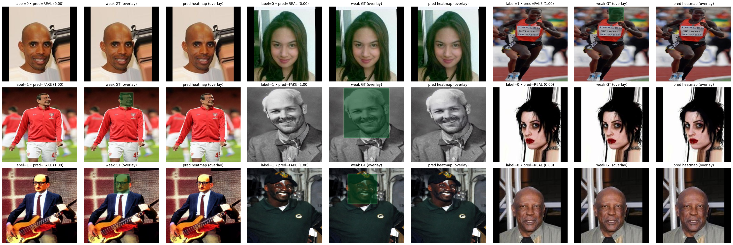
Qualitative: Weak Localization
Real: sparse/diffuse response; Fake: concentrated in face/borders.
Aggregated over TTA views.

Slide 21
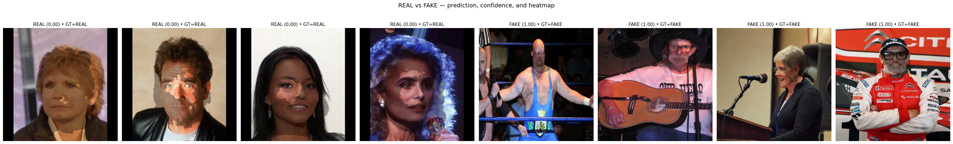
Red‑team training: closes most gaps.
TTA: further reduces calibration error; keeps clean intact.
Weak priors: better energy/precision in ROI; strict IoU ~0 by design
IoU under weak labels is more a measure of annotation granularity than of model capability.

Slide 22
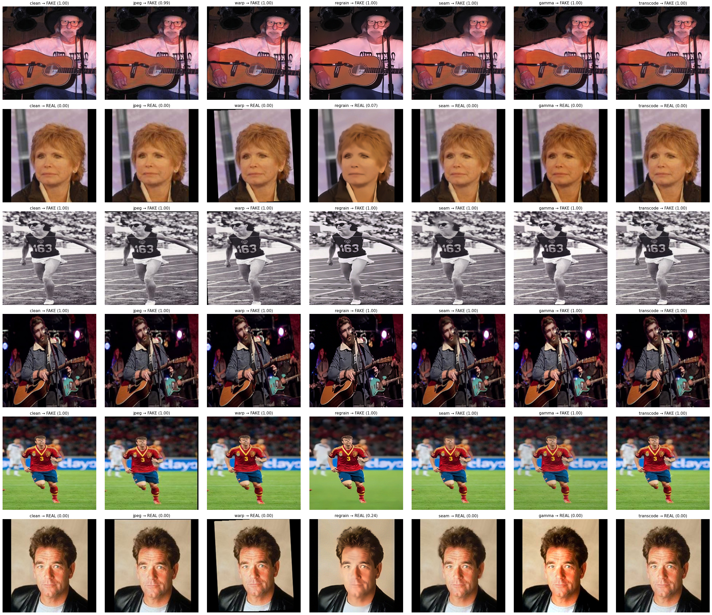

Slide 23
Contributions & Novelty
Unifies worst-of-K training + randomized TTA with two-stream fusion and a weak-supervised FPN head, then scores worst-case behavior and calibration with a single τ*—a combination not reported in prior deepfake forensics.
Worst-of-K red-team training + randomized TTA → stable, attack-aware decisions.
Two-stream content + residual with P2 injection → preserves forensic cues.
Weak-supervised FPN head → useful heatmaps without dense labels.
Deployment metrics (τ*, ECE/NLL/Brier, AURC) → reliability beyond AUC.

Slide 24
Limitations & Future Work
Weak priors ≠ pixel‑accurate masks → hard IoU low.
No guarantees vs fully adaptive adversaries. Image‑only.
Extend priors beyond faces; collect finer‑grained annotations.
Video: temporal aggregation; audio‑visual fusion.
Learned/adaptive counter‑forensics for harder stress tests. Domain adaptation for low‑light/compression.

Slide 25
Thank you

